Slide 1
Technology for Success: Computer Concepts

Slide 2
Module 2
The Web

Slide 3
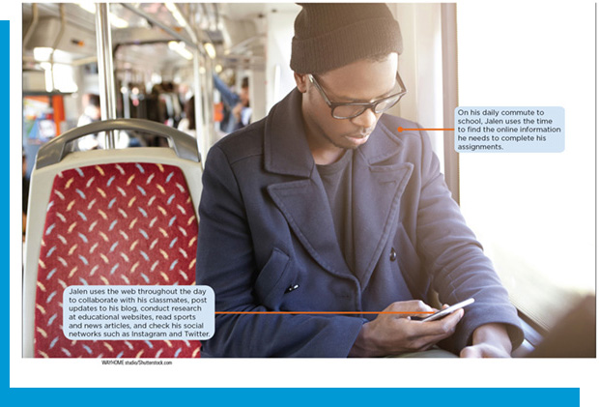

Lesson Objectives
Explain the role of the web in daily life
Describe websites and webpages
Use e-commerce
Explain how information literacy applies to web searches and research
Conduct online research

Slide 4
The Role of the Web in Daily Life
Define web browsing terms
Explain the purpose of a top-level domain
Describe Internet standards

Slide 5
Define Web Browsing Terms (1 of 3)
Web Browsing Terms
Internet
Webpage
Website
Browser
Navigate
Home/Start page
Hyperlinks

Slide 6
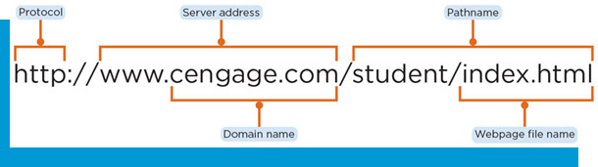
Define Web Browsing Terms (2 of 3)
Keep Track of Webpages
Uniform resource locator
Protocol (Hypertext Transfer Protocol, H T T P)
Server address
Pathname
File name
Web server
I P address
Domain name

Slide 7
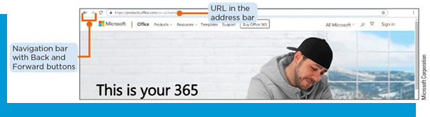
Define Web Browsing Terms (3 of 3)
Navigate the Web
Address bar
Cache
Breadcrumbs
Navigation bar

Slide 8
Explain the Purpose of a Top-Level Domain
Top-Level Domain (T L D)
Table 2-2: Popular T L Ds in the United States
T L D | Generally used for
.biz | Unrestricted use, but usually identifies business
.com | Most commercial sites that sell products and services
.edu | Academic and research sites such as schools and universities
.gov | U.S.government organizations
.int | International treaty organizations
.mil | Military organizations
.mobi | Sites optimized for mobile devices
.net | Network providers, I S Ps, and other Internet administrative organizations
.org | Organizations such as political or not for profit (any website can have the .org T L D but, traditionally, only professional and non-profit organization such as churches and humanitarian groups use it)
.pro | Licensed professional

Slide 9
Describe Internet Standards
Internet Standards
Internet Engineering Task Force (I E T F)
World Wide Web Consortium (W3C)

Slide 10
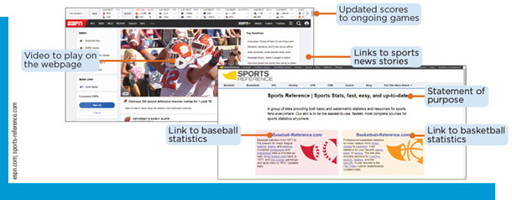
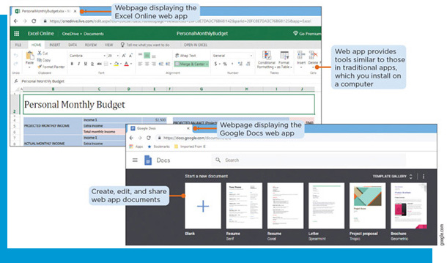
Describe Websites and Webpages
Identify the types of websites
Explain the pros and cons of web apps
Identify the major components of a webpage
Identify secure and insecure websites

Slide 11
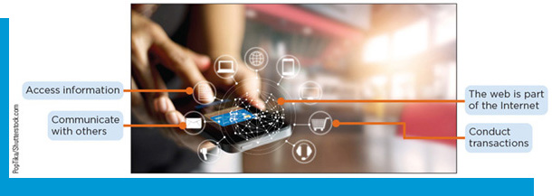
Identify Types of Websites
Categories
Banking and finance | Entertainment | Portals
Blogs | Government or organization | Retail and auctions
Bookmarking | Health and fitness | Science
Business | Information and research | Search sites
Careers and employment | Mapping | Travel and tourism
Content aggregation | Media sharing | Website creation and management
E-commerce | News, weather, sports, and other mass media | Web apps and software as a service (SaaS)
educational | Online social networks | Wikis and collaboration

Slide 12
Explain the Pros and Cons of Web Apps
Pros | Cons
Access web apps from any device with a browser and Internet connection. | You must be online to use web apps.
Collaborate with others no matter their location. | Your files are more vulnerable to security and privacy violations.
Store your work on the app’s website so you can access it anytime and anywhere. | If the web app provider has technical problems, you might not be able to access your work.
Save storage space on your device | If the web app provider goes out of business, you can lose your files.
Access the latest version of the app without installing updates. | Web apps often offer fewer features and may run more slowly than installed apps.

Slide 13
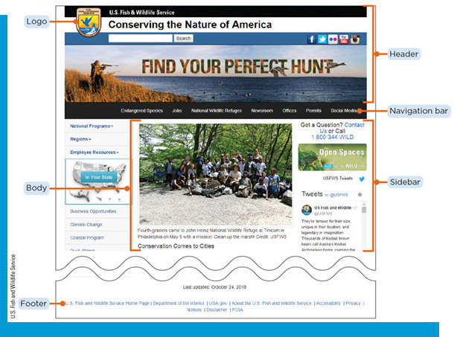
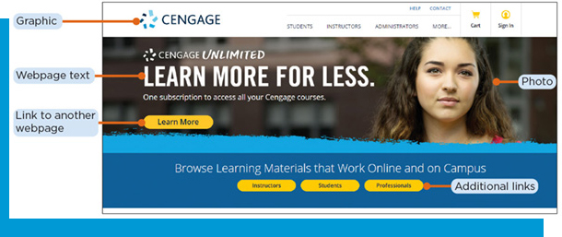
The Major Components of a Webpage
Five Major Areas
Header
Navigation bar
Body
Sidebar
Footer

Slide 14
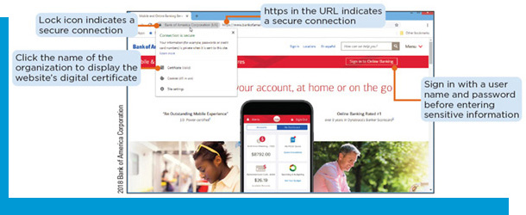
Identify Secure and Insecure Websites
Secure Websites
Use encryption to safeguard transmitted information
Hypertext Transfer Protocol Secure (H T T P S)
Use digital certificates to vouch for authenticity of the website
Lock icon
Requires sign-in with username/password before entering sensitive information

Slide 15
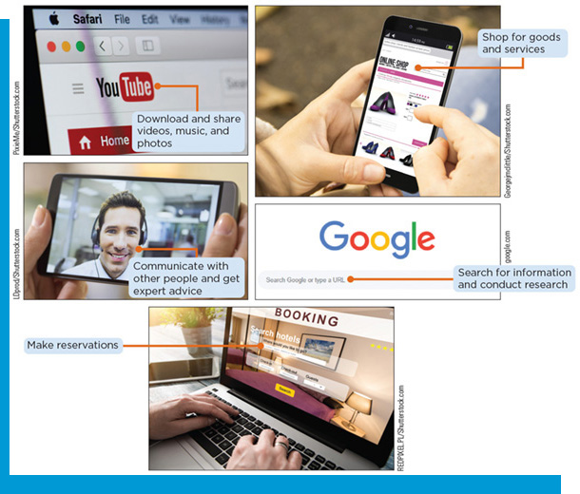
Use E-Commerce
Explain the role of e-commerce in daily life
Use e-commerce in business transactions
Use e-commerce in personal transactions
Explain how to find e-commerce deals

Slide 16
Explain the Role of E-Commerce in Daily Life (1 of 2)
Types of e-commerce websites
Type of E- commerce | Description | Example
Business-to-consumer (B2C) | Involves the sale of goods and services to the general public | Shopping websites
Consumer-to-consumer (C2C) | Occurs when one consumer sells directly to another | Online auctions
Business-to-business (B2B) | Consists of business providing goods and services to other business | Market research websites

Slide 17
Explain the Role of E-Commerce in Daily Life (2 of 2)
Pros and cons of e-commerce for consumers
Pros
Variety
Convenience
Budget
Cons
Security
Fraud
Indirect experience

Slide 18
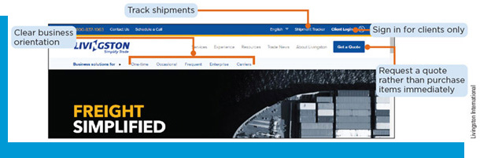
Use E-Commerce in Business Transactions
B2B E-Commerce
Transferring goods, services, or information between businesses
Pricing can vary based upon the level of service provided, negotiated terms, and other factors
A team of people often review and make a purchasing decision

Slide 19
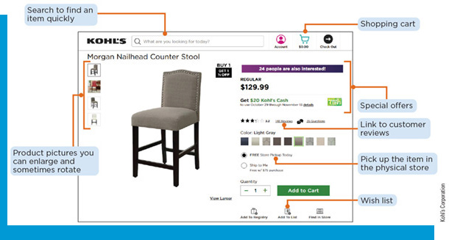
Use E-Commerce in Personal Transactions
B2C/E-Retail
Electronic storefront
Tracks your selected items using cookies
Make secure e-commerce payments
3D Secure
Transport Layer Security (T L S)
Online payment services

Slide 20
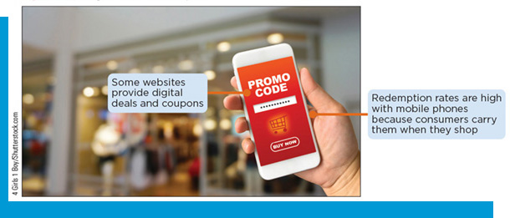
Explain How to Find E-Commerce Deals
Find Online Deals
Comparison shopping sites
Using digital deals
Gift certificates
Gift cards
Coupons

Slide 21
Apply Information Literacy to Web Searches
Define information literacy
Explain how search engines work
Use search tools and strategies
Refine web searches

Slide 22
Define Information Literacy
Information Literacy
How one finds, evaluates, uses, and communicates online information
Allows one to:
Navigate many sources of information, including the Internet, online libraries, and popular media sites.
Select the right tool for finding the information you need.
Recognize that not all information is created equal.
Evaluate whether information is misleading, biased, or out of date.
Manage information to become a knowledgeable decision maker.

Slide 23
Explain How Search Engines Work
General Search Engine
Compiles a database of information about webpages
Uses software programs called spiders or crawlers to build an index of terms and their locations
When one enters a query, the search engine refers to its index and lists pages based on how closely they answer the query
Ranking depends on how often and where a search term appears on the webpage, how long the webpage has been published, and the number of other webpages that link to it

Slide 24
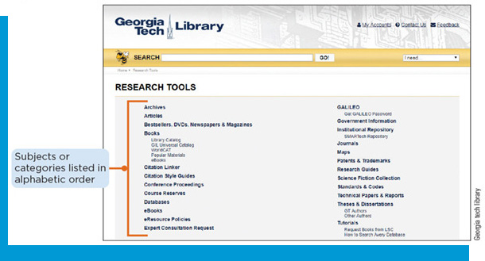
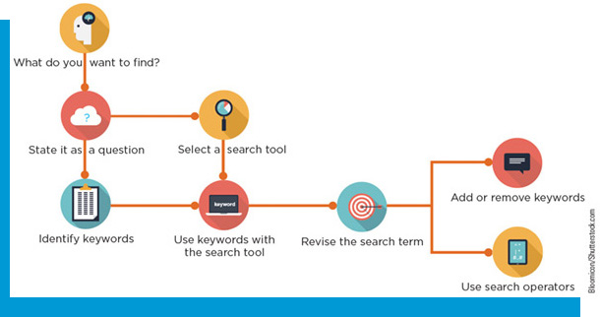
Use Search Tools and Strategies (1 of 2)
Search Tools
Find online information based on criteria you specify or selections you make
Search engines
Search boxes on webpages
Web directory or subject directory
Specialized search tools concentrate on specific resources

Slide 25
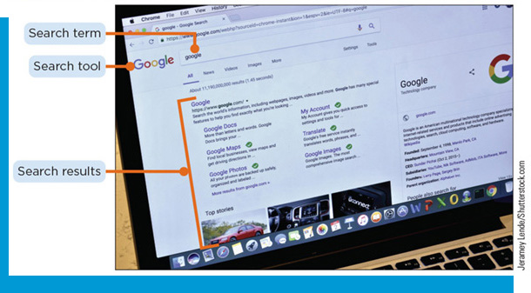
Use Search Tools and Strategies (2 of 2)
Use a Search Strategy
State what kind of information you are seeking, as specifically as possible
Phrase the search term as a question
Identify the keywords or phrases that could answer the question
Select an appropriate search tool
Perform the search, and refine the web search to narrow or broaden the results
Use a word stem to help broaden results

Slide 26
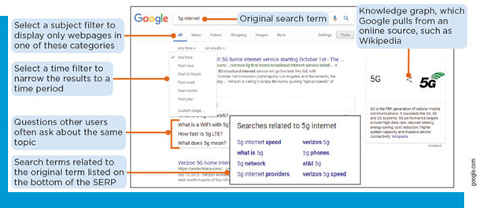
Refine Web Searches (1 of 3)
Learning from the Search Engine Results Page (S E R P)
Subject filters
Time filters
Questions other users often ask about the same subject
Search terms related to the original term
Knowledge graph pulled from online sources

Slide 27
Refine Web Searches (2 of 3)
Search Engine Practices
Lists the most relevant results, or hits, on the first page.
Results labeled as an “Ad” or “Sponsored link” are from advertisers
Each type of filter offers related features
Google displays a “People also search for” list below a link you visited

Slide 28
Refine Web Searches (3 of 3)
Boolean Operators
Table 2-6: Common search operators
Operator | Means | Example
“” (quotation marks) | Find webpages with the exact words in the same order | “augmented reality” in business
| (vertical bar) | OR | augmented | virtual
- (hyphen) | NOT | augmented reality – virtual
* | Wildcard (placeholder for any number of characters) | augmented* reality
#..# | Find webpages within a range of numbers | augmented reality 2017..2022

Slide 29
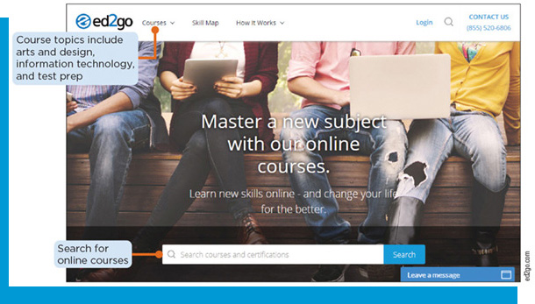
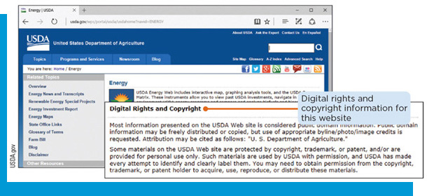
Conduct Online Research
Use specialty search engines
Evaluate online information
Gather content from online sources
Apply information literacy standards

Slide 30
Use Specialty Search Engines
Specialty Search Engines
Let one search information sources that general search engines do not always access
Search tool | What it does
Wolfram Alpha | Answers factual questions directly, without listing webpages that might contain the answer
RhythmOne | Finds videos or other multimedia; uses speech recognition to match the audio part of a video with your search term
Ask a Librarian | Connects you to librarians at the Library of Congress and other libraries; allows you to engage in an online chat or submit your question in an online form
TinEye | Does a reverse search for submitted images, rather than keywords, to locate the original image and match it with other indexed images

Slide 31
Evaluate Online Information
The CARS Checklist
Credibility: identify the author and check credentials
Accuracy: verify facts and claims, check for bias
Reasonableness: examine whether the claims are fair and sensible
Support: look for reputable sources and authorities

Slide 32
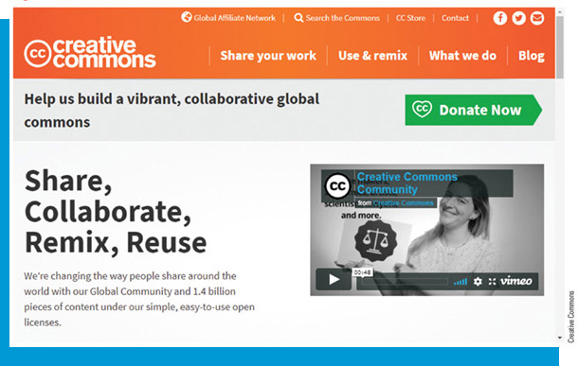
Gather Content from Online Sources
Follow Ethical Guidelines
Copying photos might violate intellectual property rights
A copyright gives authors and artists the legal right to sell, publish, or distribute an original work
Some online resources are protected by digital rights management (D R M), which limit access to propriety rights
Some material is in the public domain and can be used without permission
The fair use doctrine allows one to use a sentence or paragraph of text without permission with citation to the original source
Creative Commons (C C): a nonprofit organization that helps content creators keep copyright to their materials while allowing others to use, copy, or distribute their work

Slide 33
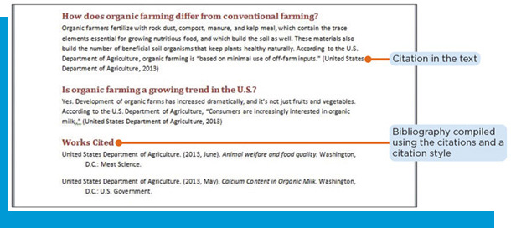
Apply Information Literacy Standards
Citing Sources
A citation is a formal reference to a source
Each type of information source uses a different citation style
Failure to cite sources, even if some of the words are changed or paraphrased, is plagiarism

